Slide 1
INVESTMENT CASE STUDY SUBMISSION

Slide 2
Abstract
The CEO of <Investment Company> wants to determine the best investment strategy. Some of the key constraints for these investments are: -
Funding amount in the range of 5 to 15 M USD per round of investment.
Invest only in English speaking countries.
Investment methodology: -
Overall guiding strategy is <Investment Company> wants to invest where other others are investing.
It wants to identify the best sectors, countries, and investment type (from Seed, Angel, Venture and Private Equity).
The objective of this study is to analyze the trends based on above guiding principles and come up with the suggestions for the CEO of <Investment Company>.

Slide 3
Problem solving methodology
Ensure funding details are present for all companies in rounds2
Create one file by merging the companies & rounds2 data, for investment analysis
Determine avg. investment/round in each of the 4 key funding type (Seed/Angel/Venture/PE)
Choose the investment type with avg. investment range between 5 to 15 Million USD
Map the primary category to one of the 8 sectors (from mapping file)
Identify the top 9 countries for chosen investment type (by investment amount)
Manually review and identify key countries/sectors
Identify the top 3 sectors for each of the top 3 English speaking countries
Identify the top 3 English speaking countries from this list

Slide 4
Analysis – Business and Data Understanding
The first step is to understand the business requirement and available data (companies, rounds2 and mapping files) using the following steps –
Business Understanding – <Investment Company> wants to invest between 5 to 15 Million USD in companies/sectors/countries where most investment companies are already investing in. Also, they want to focus only on English speaking countries.
Data Understanding –
Companies file – Contains basic data like company name, permalink, country details etc.
Rounds2 file – Contains details of funding rounds.
Since the entire analysis is based on funding rounds, rounds2 could be taken as the master file.
Validate if all companies (using the permalink field) in rounds2 are present in companies dataset. This comparison needs to be case-insensitive.
The next step is to merge the 2 files on permalink field to perform investment analysis. Based on the analysis, its determined that there are 66368 unique companies. There are a total of 114949 records in the merged file.

Slide 5
Analysis – Data Cleaning and Analysis
The next step is to perform data cleaning and analysis/aggregation etc. using the following steps –
Calculate the average funding/round for each funding type. Chose the funding type which is between 5 to 15 Million USD. The funding type identified is “Venture”.
Identify the Top 9 countries which receive the total highest funding for the chosen investment type from step 1 above.
Map the Top 9 countries fetched from the previous step against the English speaking countries. Identify the top 3 English speaking countries. Top 3 countries identified are USA, Great Britain and India.
Map the Primary category in the merged file with the mapping file provided.

Slide 6
Analysis – Evaluation and Recommendation
The final step is to review the Funding type, top sectors and countries and come up with investing suggestions for <Investment Company> –
Next step is to identify the most heavily invested sectors in each of the top 3 countries identified in the previous step.
Based on the analysis conducted list out the top 3 sectors in each of the top 3 countries according to the funding type chosen. Conclusions are present in the final slide.
The key data points are also plotted in Tableau to help highlight they key points of this case study.

Slide 7
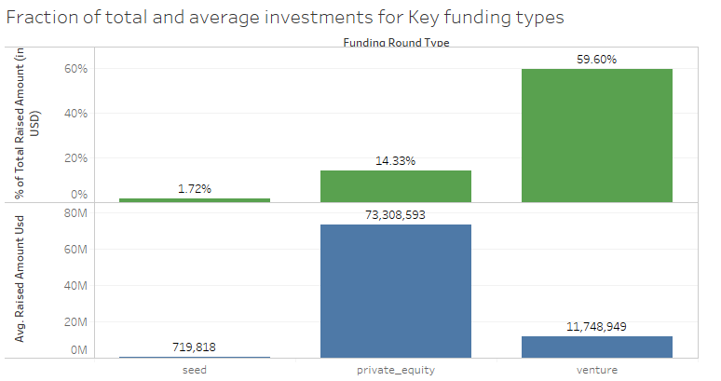
Results
Insights
Venture is the funding type with ~60% of the total funding (across all types and countries)
Average Funding per round of investment is 11.7 Million USD for Venture Funding Type and is likely the type <Investment Company> would go for.

Slide 8
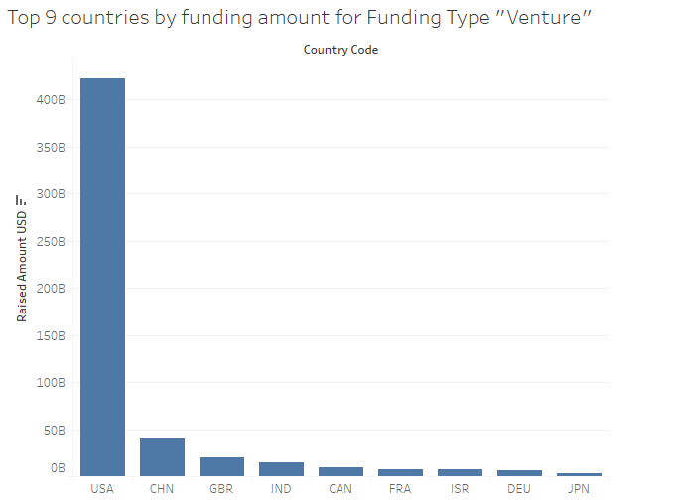
Results
Insights
USA, China, Great Britain, India and Canada are the countries with highest Venture investments.
USA, Great Britain and India are the 3 countries <Investment Company> is likely to invest in (As they are English speaking).

Slide 9
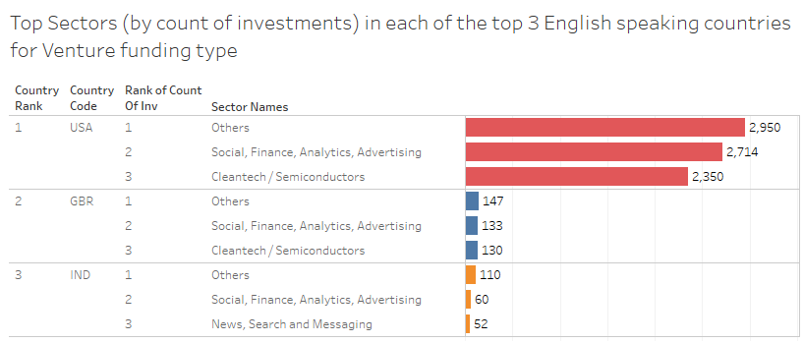
Results
Insights
The top 3 sectors, most likely, would be
Others
Social/Finance/ Analytics
Cleantech/ Semiconductors
Average Funding per round of investment is 11.7 Million USD for Venture Funding Type.

Slide 10
Conclusions
Based on the Analysis, following are our recommendations for <Investment Company>:-
The funding type suitable for <Investment Company> would be “Venture”.
Companies with most Venture funding's are mainly located in USA, UK, China, and India. As <Investment Company> wants to focus the investing in English speaking countries, they are suggested to invest their available budget as below –
In USA (close to 90% )
In GBR(6-7%)
In India (3-4%)
Following are the sectors, <Investment Company> is suggested to invest its available budget –
Others (~40% of the total budget, split in the ratio among the 3 countries from the above recommendation)
Social/Finance/ Analytics (~30% of the total budget, split in the ratio among the 3 countries from the above recommendation)
Cleantech/ Semiconductors (~28% of the total budget, split between USA and GBR in the ratio 5:1)
News, Search and Messaging (~ 2% of the total budget, only in India)

